Slide 1
Indiana QSO Party
Prepared by
Mel Crichton, KJ9C
Notes:
Since 2002 the Indiana QSO Party has been sponsored by the Hoosier DX and Contest Club that meets in Indianapolis once a month. Members include a number of top operators and some little pistols.
Some of our members have won numerous radio contests and competed in the World Radio Team Contesting event (to be held in Russia this year). Others are on the DXCC Honor Roll. And most of us just like to get on the air, even if we win nothing.
All are willing to share their knowledge about contesting or working DX.

Slide 2
What is a QSO Party?
Short operating event
  8 hours to 2 days long (IN QP is 12 hours)
Theme
  Geographic – state, call area
  Club QSO Party – FISTS, QCWA, FOC
Usually scored like a contest
  Points for contacts (2 CW, 1 SSB in INQP)
  Multipliers (states, DX, IN counties)
  OK to re-Work mobiles/rovers after they change counties

Slide 3
What state parties?
Almost every state has one
  in every month of the year (43 in 2023)
Indiana QSO Party (INQP) is first Saturday in May (May 4, 2024 )
  160-10 meters (no WARC), SSB & CW
Also regional parties our weekend
  7QP, New England QP, Delaware,etc.
Notes:
It happens that there are FOUR QSO parties on May 1….
Indiana
W7 QSO Party… a chance to add multipliers by working all those W7s that want to work YOU!
New England QSO Party – ditto for all the W1s in six more states (multipliers)
And the county hunter QSO party… they want to work YOUR county…. And they REALLY want to work Indiana mobiles, which are extra points.
All of the others will give you their state and county in the exchange. If you’d like to play in their contests as well, be sure to log their county as well as state.

Slide 4
What activity is planned?
Most QPs have a web page & reflector
  E-Mail plans, questions, discuss and brag
  Activity map or list
INQP has both:
  Info, rules & map at www.hdxcc.org/inqp
  Reflector is at http://inqp@groups.io
Notes:
You can sign up for the reflector on the web page.
There won’t be much reflector activity until late March and April, but then it will get heavy.
There are a number of references in the INQP web page links. One of interest is the Indiana map showing activity by county….. A LOT of counties are very active, others are very rare

Slide 5
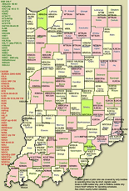
Planned Activity
map
(example)
many mobiles, portables and rovers
Notes:
Since 2002 the Indiana QSO Party has been sponsored by the Hoosier DX and Contest Club that meets in Indianapolis once a month. Members include a number of top operators and some little pistols.
Some of our members have won numerous radio contests and competed in the World Radio Team Contesting event (to be held in Russia this year). Others are on the DXCC Honor Roll. And most of us just like to get on the air, even if we win nothing.
All are willing to share their knowledge about contesting or working DX.

Slide 6
Why do IN QP?
Be the target of a pileup (feels like being DX)
  Rare county or on a county line = REALLY busy!
Shake down your mobile/portable station
  Test the Field Day setup
  Test emergency equipment under a 12 hour load
Improve contest & message handling skills
Improve CW skills or get over mic. fright
Fill the log – can make MANY QSOs in 12 hrs
Plaques and certificates
Notes:
The rate meter on the logging software at KJ9C/mobile has often been over 120/hour for short bursts….. That’s a lot of calls to pull out
The weather is usually good enough that a tent and generator – or a state park shelter – will suffice for your portable operation

Slide 7
2023 IN QP
600+ logs submitted worldwide
Almost all 92 counties with at least one station
Over 100 IN stations on the air
Results are posted on website
  www.hdxcc.org/inqp (Scores)
Notes:
Many little pistols and casual operators from Indiana got on the help the effort, and sent in logs for as few as ONE QSO.
We hope to see even more logs in 2024

Slide 8
What skills do I need?
One or both of 2 modes:
  INQP is 160-10, SSB and CW
The desire to make contacts
  Butt in chair up to 12 hours
Ability to keep a legible log (more later)
Notes:
You’ll find a lot of fixed stations working SSB, because they can put louder signals on the air than a mobile with an 8 foot antenna.... VHF and digital modes have not been popular in other state parties....
But because of this, mobiles tend to prefer CW, as they can be heard and even hold a “run” frequency. So look in the CW band for new Indiana multipliers, or look in the phone bands for more states.
But don’t count the mobiles out on phone. They can work a county on CW for a multiplier, then on phone for another multiplier. So don’t be surprised to hear an Indiana mobile reply to your SSB CQ.
But to be sure you hear him, once in a while when calling CQ say “mobiles only please”….. Or his signal will be buried under everybody else’s
Obviously the more time you spend on the air the more contacts you make. But activity picks up in late afternoon and after dark, especially on 80 meters.
Logging will be discussed later

Slide 9
My Station?
There’s always HF activity in a QSO party
  40 meters most popular (local and DX QSOs)
Rig, antennas, logging system
  Fixed station – 100 watts and low dipole : 80,40,20
    10-15 will likely be less busy in 2019
  Mobile – 20-40-80 meters and CW are advantages
  Portable/Rover – good antennas are a plus
Operators – Tech’s can operate SSB and CW on some HF bands or guest/club operate on all bands
Notes:
Ain't no meters like 40 meters. Forty will be good in early afternoon for in-state and Midwest, then it’ll go real long so you can work those W1s, then longer... after dark for W6/W7 and DX. At dusk, you’ll want to try 80 and it will also go long later. dont forget to check 80 meters early for in-state activity Likewise a few stalwarts may show up at the suggested 160 meter operating time (0200Z).
Don’t forget 20, 15 and 10 meters…. Twenty will be good early for getting states as multipliers…. Likewise 15 and maybe ten. The more bands you work the better your chance of working a station multiple times.
But you really want to try to get to 80 later.
There have been a few requests for VHF, but other states with VHF in their QSO parties have seen almost no activity. Need ground wave to make in-state contacts (got to be close) and there’s very little sporadic-E the first weekend of May for distance QSOs.
No general or Extra class? Operate in a multi-op or as a guest operator at somebody else’s station.
You guys with good HF stations – invite a Tech class to try HF.

Slide 10
Don’t think about winning
Think about:
-Making Indiana heard
-Improving your skills
-Improving your station
-Having FUN!
Notes:
This is our state’s one day to make ourselves heard. We have lots of support from our ARRL section manager (he sent in a log) and ARRL itself.
We also have support from the sponsors of the W7 and New England QSO parties, who WANT to work Indiana stations... n1MM software will log contacts with W1 and W7 as well as Indiana,
Give it a try… be sure to remember “It’s only a QSO Party” so you can HAVE FUN

Slide 11
Logging?
Indiana - NO MORE handwritten logs
Prefer computer-generated logger files via e-mail
  Accuracy guaranteed, easier to score
  Cabrillo format advised
  Most logging programs create acceptable entry files
    TR4W, WriteLog, NA, N3FJP, LOGic, CQ/X
    N1MM+ is free, works for simultaneous state QP’s
    (our recommended choice for new log usesrs)
    Logging software can fill in band/mode and send CW for you
  Submit just one BIG log with contacts from all four QSO parties. The scorers’ software can find the QSOs for that party and score them for you.
Notes:
We prefer electronic format logs, preferably in Cabrillo format…. But some folks have kept logs in Excel and edited them to enter each of the four QSO parties that weekend. All the logs eventually go into Excel anyway for log checking
At minimum - Need date, time, band, mode, station, his QTH, your QTH
N1MM is free, can generate a Cabrillo file, and if you know how it works it will cover all 4 QSO parties, check accuracy of your typing, and send CW for you

Slide 12
Scoring?
No need to score your log
  Log checker does that anyway
  You can calculate unofficial CLAIMED score
  Please post your score on 3830scores.com
How about INQP weekend with Four* QPs going on at once?
  Generate ONE log, let the log checker throw out the QSOs that do not apply to INQP
  Logging program in GENERAL QSO mode or use N1MM Logger, others (test before May !!!)
* INQP, 7QP, DEQP and NEQP… also Italian ARI contest
Notes:
You can claim a score, but well calculate it any way
N1MM is free, can generate a Cabrillo file, and if you know how it works it will cover all 4 QSO parties, check accuracy of your typing, and send CW for you
Some use TR or other logging programs in GENERAL QSO mode… it sends CW exchanges but accuracy is whatever you type in…. If you goof, the program won’t check it

Slide 13
The EXCHANGE
Send Call, signal report and your county.
Examples of your messages:
SSB : “CQ INQP KJ9C KJ9C in Brown County”
“W0AG thanks. 5-9 Italy November Bravo Romeo Oscar”
“ Thanks. KJ9C INQP”
CW: “CQ INQP KJ9C KJ9C /BRO”
“DE W0AG”
“W0AG 599 INBRO”
“TU KJ9C/BRO”
Note that the county abbreviation for logging is FIVE characters that start with “IN”… INBRO is Brown county Indiana.

Slide 14
Let em know your county... often!
Use the county list at http://www.hdxcc.org/inqp/counties.html
Mobiles/Rovers/Portables... let folks know you are in a new county:
When calling CQ :
“CQ INQP de KJ9C/BRO” so you don’t have folks asking “COUNTY?”

Slide 15
How high can I score?
Fixed stations –
  HP 900 QSOs - LP 500 QSOs - M/M 1800+
Portable
  HP 1200+ QSOs (accounts for county line x2)
  LP 500 QSOs (one county)
Mobile – 100 watts – 600+ QSOs
Club aggregate– 350 K points- easy target!!!
RECORDS FOR EACH COUNTY BY CLASS
  See INQP web page
Notes:
Although the rate meter may hit 120 or more at times, it’s not uncommon for the AVERAGE rate to be more like 50 an hour.
If you’re not used to making contacts this fast, fifty may seem overwhelming.
And whatever your score, be sure to list your Indiana club affiliation to help the club win the overall club plaque.
Note that HDXCC is not eligible – we are the sponsor.
You can also go for the record in your county – or another county.

Slide 16
PRIZES?
Certificates for notable effort
Plaques for top scores in INQP classes
You can also add to these awards:
Worked All States,
USACA awards
  Worked All Indiana Award
Notes:
Notable effort means that you got on the air long enough to outdo everybody else in your class.
Plaques depend on level of activity…. There’s no cutoff number, so we might award a plaque for a big scoring entry where there were only two other entries….
Of course you will work a lot of state and counties, and probably some DX as well. INQP has “regulars” such as LY3BA, a few DLs, and a couple of Russians.

Slide 17
IN QP Prizes ?
Sponsored Plaques for top scores in:
  HP, LP, QRP single op fixed stations Indiana
  HP, LP, QRP out of state
  Top multi-operator (M/S and M/M) entry from Indiana
  Indiana mobile
  Indiana portable
  Indiana Rover
  Top from Black Hole (Basically W9 outside Indiana)
  Top W1, W4, and W7 entries
IN CLUB AGGREGATE plaque (sponsor HDXCC)
  3 or more club members participate – see rules
Certificate for county winner - possible
Notes:
Plaques are sponsored…. If you want to sponsor a plaque contact KJ9C (address on last slide). Cost is about 40
dollars.
The Indiana Radio Club Council sponsors the plaque for top club (total of all club members’ scores)
The Bison Stampede was a SECOND competing Indiana QSO Party back in the 1990s, with a different sponsor. Because of the competition, there was little activity in either event.
We combined the two events into one QSO party in 2003. W9UUU is the official Bison Stampede station representing the Indiana Radio Club Council, and is usually located near Terre Haute.

Slide 18
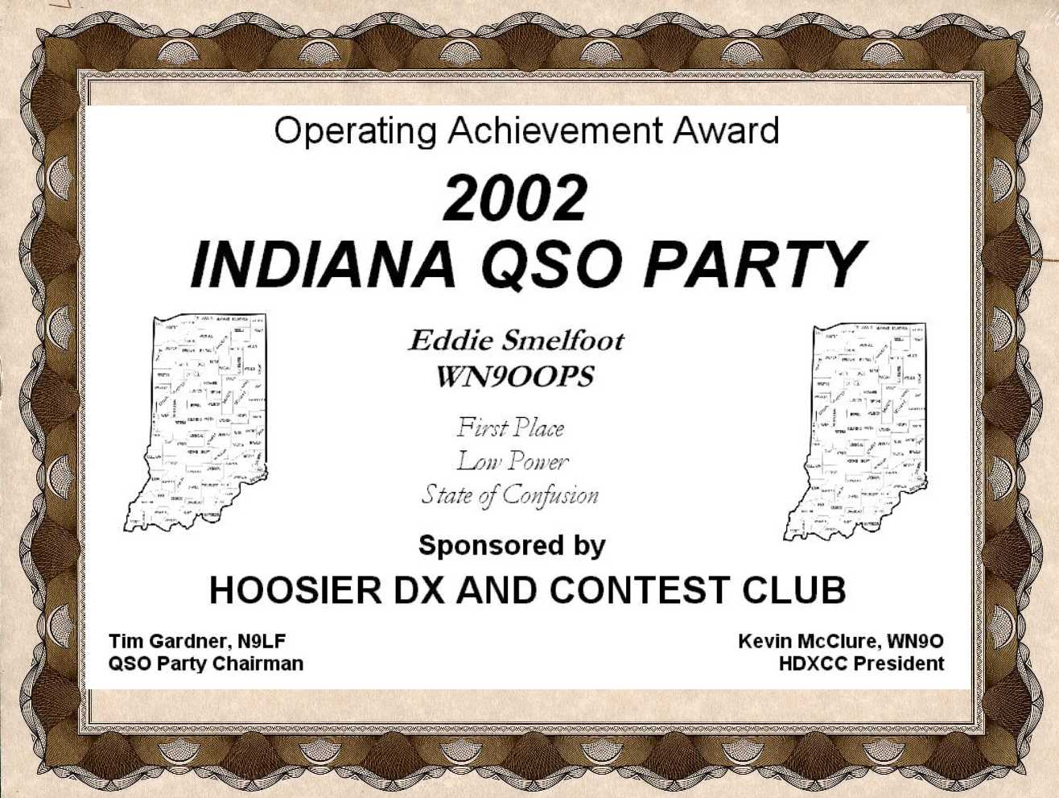
Awards
Notes:
Since 2002 the Indiana QSO Party has been sponsored by the Hoosier DX and Contest Club that meets in Indianapolis once a month. Members include a number of top operators and some little pistols.
Some of our members have won numerous radio contests and competed in the World Radio Team Contesting event (to be held in Russia this year). Others are on the DXCC Honor Roll. And most of us just like to get on the air, even if we win nothing.
All are willing to share their knowledge about contesting or working DX.

Slide 19
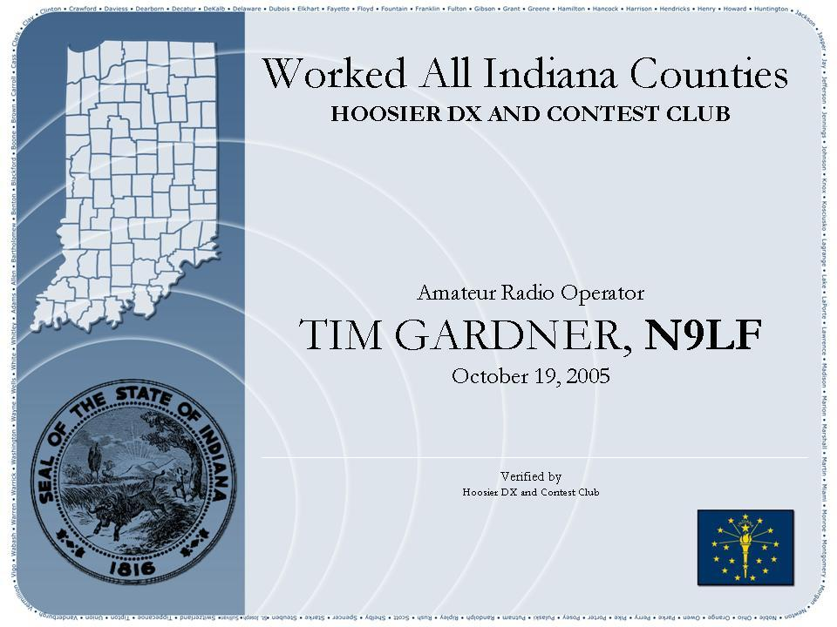
Worked All
Indiana Counties
Info at www.hdxcc.org/wai
QSL 60 of the 92 counties
  Proof of QSL Cards or INQP log confirmation..
  see HDXCC web
Notes:
There are endorsements for working more than 60 counties. But 60 is the minimum.
New this year: in lieu of collecting a QSL, you can confirm a county if you and the other guy both sent in a log for INQP. So check the LOGS SUBMITTED page (or the score summary for prior years) to see if there’s a log to confirm your QSO.

Slide 20

Rover?
Can be a mobile that stops to erect temporary antennas (antennas may be set up day before)
Can be a “Field Day” setup that changes locations (new county, can be worked again)
Mobile = Antennas must be usable while traveling (land, air, water) but may park 100% of the operating time
Portable = One location only, temporary setup (Field Day style)
Notes:
A Rover - a plaque awarded for top score. May be multi- or single operator, no power limit. Can be a mobile that moves between sites with bigger temporary antennas
A mobile (such as WN9O) may stop to use temporary dipoles set up the day before or while stopped, or they can push up a mast with a tri-bander on it.
A portable “Field Day” operation can change counties, thereby becoming a rover.
Mobiles MUST be capable of legally traveling with antennas deployed. But a mobile does not have to make contacts while in motion… in fact, if you do want to make contacts while moving we suggest getting a driver for safety.
A portable does not pull up stakes…. They set up in one location (in one or two counties) and erect whatever antennas they want. With as many operators and at whatever power level they can support.

Slide 21
Mobiles always welcome
12 volt radio and reliable battery
$15 Hamstick - or more $$$ antenna
Computer log on laptop interface to rig
  easier than paper, especially on the move
A map and a route PLAN
Options to make life easier:
  GPS and mapping software (espec. if aero mobile)
  Driver (or a pilot) = safety
  Announce your planned route on county hunter sites
    W6RK.com, countyhunter.com
Notes:
Most HF radios will work on 12 volts….. Put it on the seat next to you and run heavy DC wiring from the battery (with a fuse)
Hamsticks are cheap…. Magnetic Mounts should be capable of keeping the antenna on the car at highway speeds (some won’t)….. If in doubt, guy the antenna to the hood with nylon or poly cord
Computer logging (and CW sending) are easier on rough roads than logging and sending by hand.
Your plan should include a REALISTIC schedule. You can’t cover 24 counties in 8 hours! Allow time for others to find your frequency… at least 30 minutes per county, park as long as you can, and allow time for the guys to spot you on the cluster … then get ready for the deluge
GPS helps if you are not familiar with county roads….
Some winning mobiles will use mapping software to calculate drive times and optimize routes…. But not until they have worked out the rig and antenna bugs over a few years. Murphy WILL strike (read the soapbox comments) so be prepared.

Slide 22
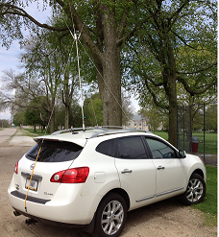
20
K9WX/m
Notes:
Note the guy ropes so the mag-mount does not fly off

Slide 23
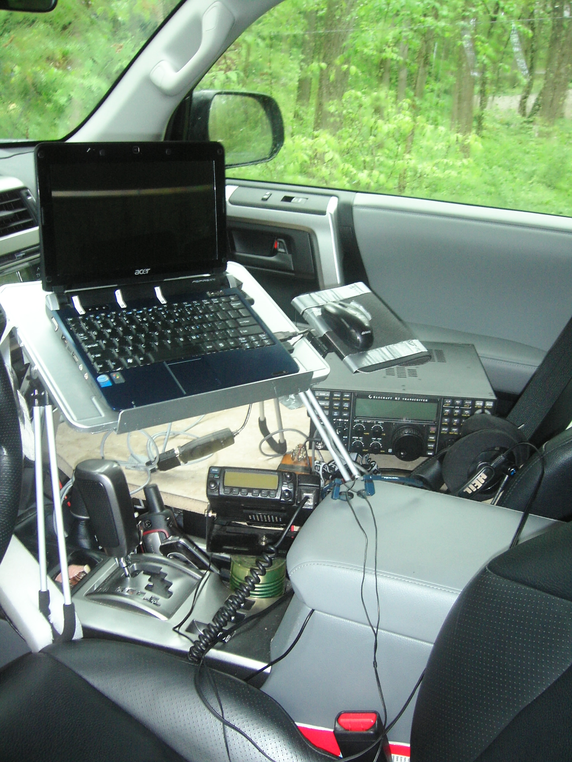
KJ9C/m solo op
Notes:
Single op mobiles should consider operating from county lines and NOT operating in motion.... but it’s your funeral

Slide 24
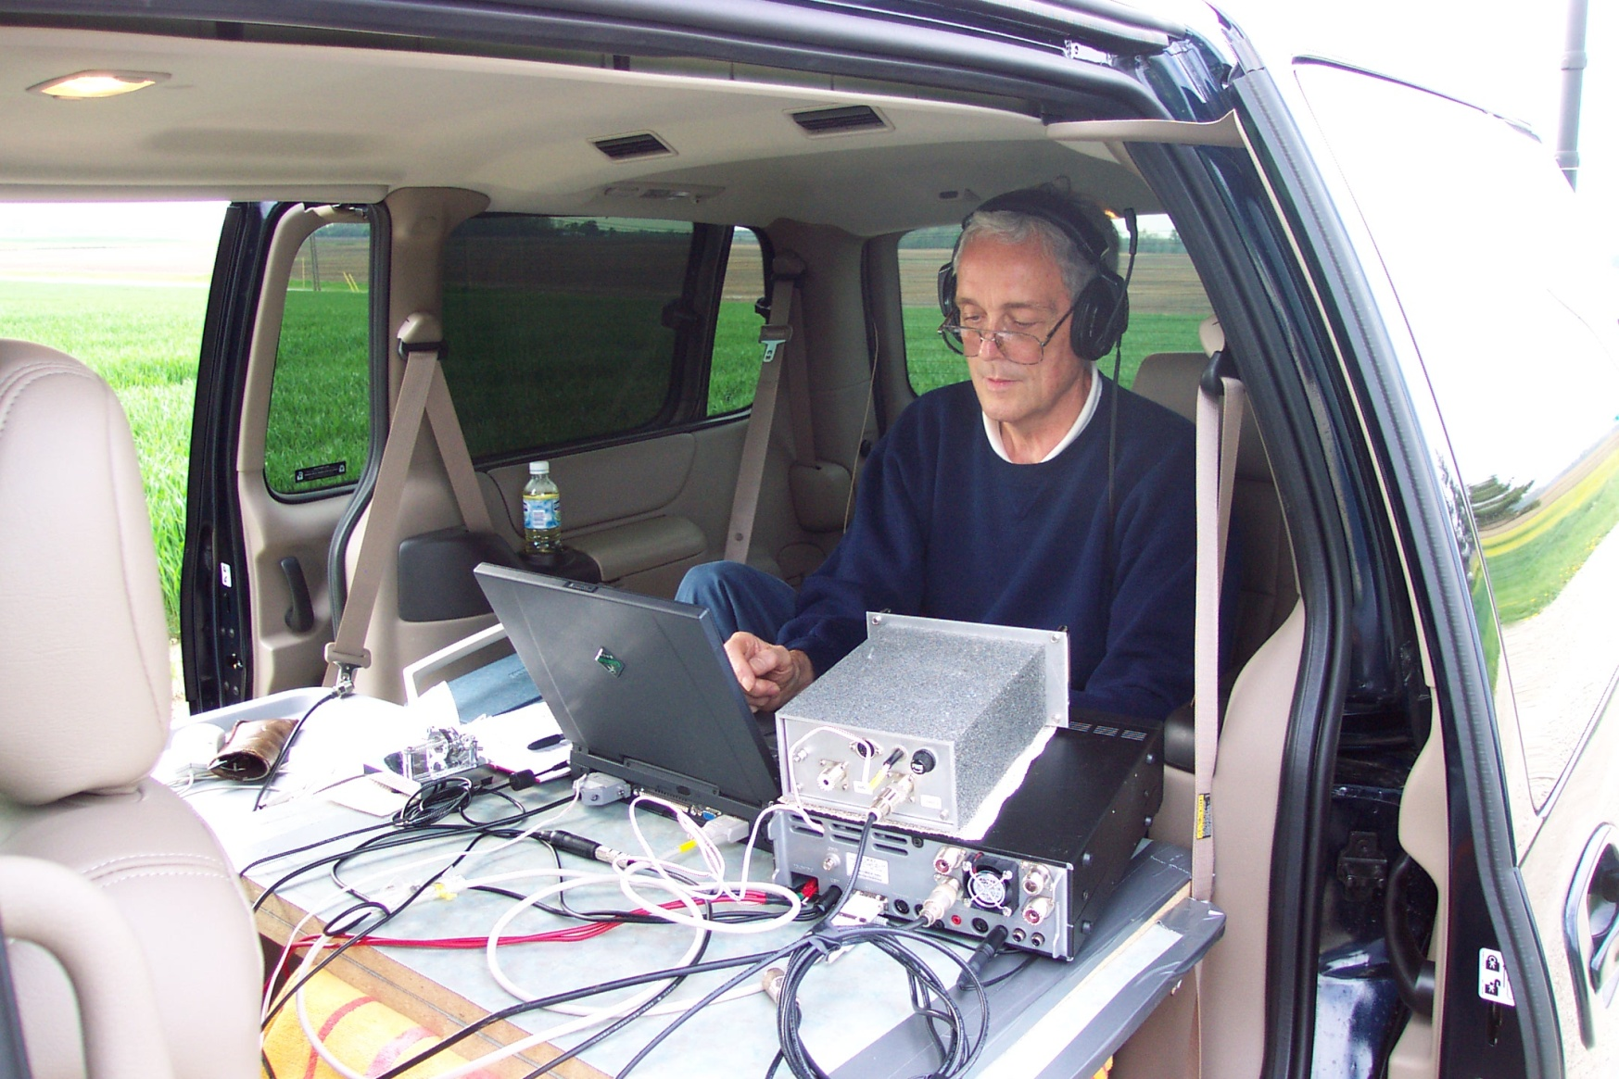
WN9O rover (W9IU Op)
Notes:
Here’s what a winning portable looks like… and he parked on a county line for double points.
But his antennas are no better than dipoles strung high in trees between two counties, and he runs 100 watts.
So …. N9FN CAN be beaten!

Slide 25
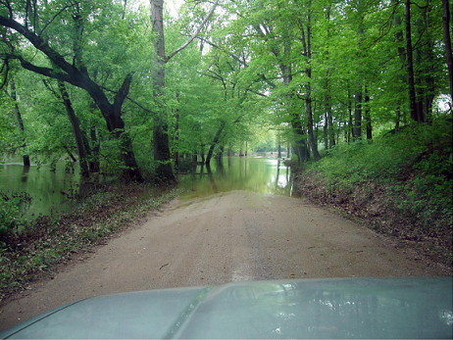
Murphy may strike have alternate routes
Notes:
Past experience says to avoid deep mud and deeper water
So …. N9FN CAN be beaten!

Slide 26
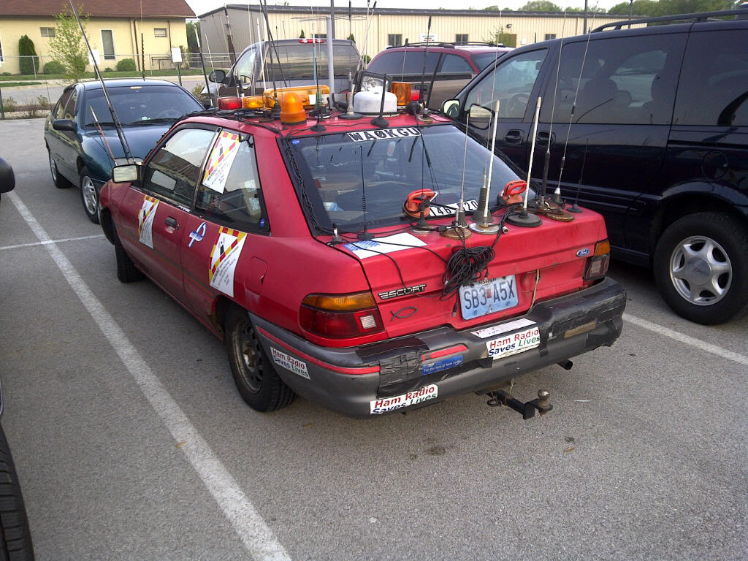
WA0KGU – Porcupine Mobile
Notes:
Here’s what a winning portable looks like… and he parked on a county line for double points.
But his antennas are no better than dipoles strung high in trees between two counties, and he runs 100 watts.

Slide 27
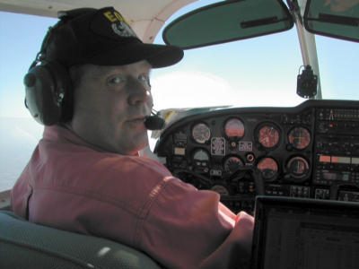
KB9AX/aero mobile
Dan (pilot) & Dave N9KT (opr)
Notes:
So …. N9FN CAN be beaten!

Slide 28
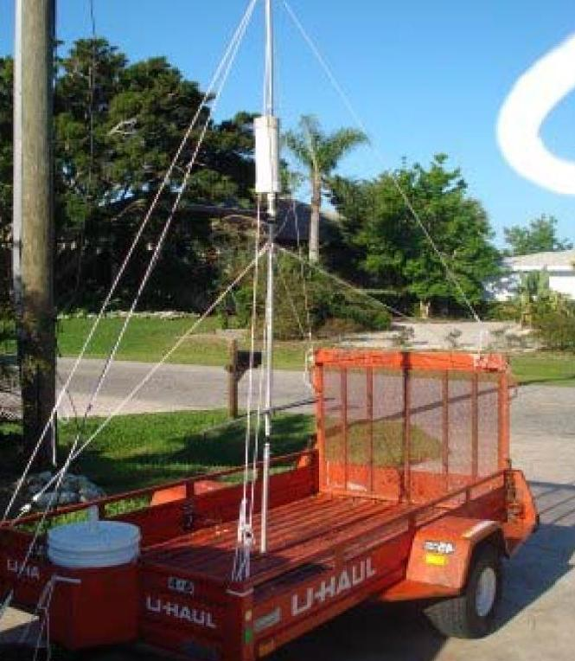
K5KG/m
FL QSO
Party
(Legal for highway travel?)
Notes:
Note there’s room for a generator and a KW amp....
But his antennas are no better than dipoles strung high in trees between two counties, and he runs 100 watts.
So …. N9FN CAN be beaten!

Slide 29
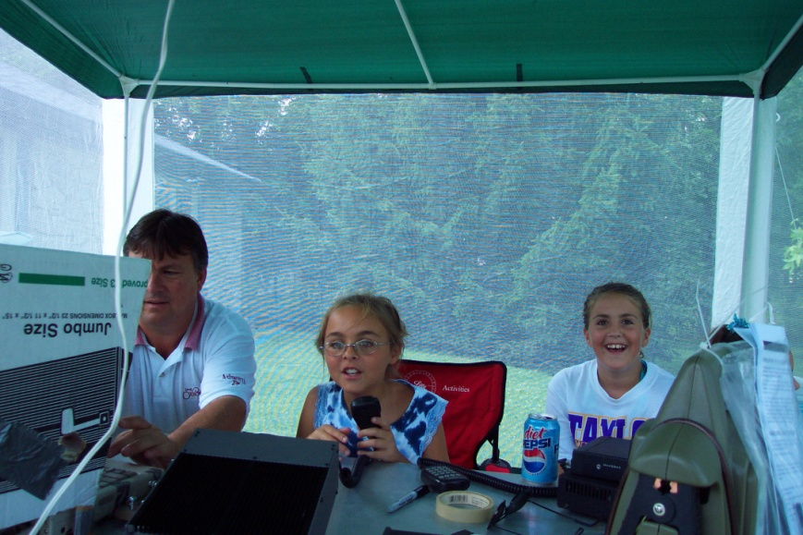
Portable?
Portable = One location only, temporary setup (Field Day style)
Can operate from a two county line
Notes:
A portable “Field Day” operation can change counties, thereby becoming a rover.
Mobiles MUST be capable of legally traveling with antennas deployed. But a mobile does not have to make contacts while in motion… in fact, if you do want to make contacts while moving we suggest getting a driver for safety.
A portable does not pull up stakes…. They set up in one location (in one or two counties) and erect whatever antennas they want. With as many operators and at whatever power level they can support.

Slide 30
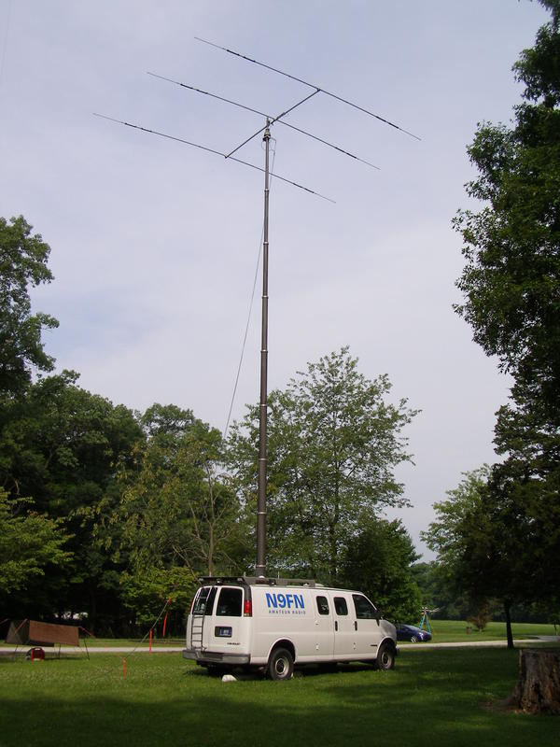
N9FN/p
Notes:
Here’s what a winning portable looks like… and he parked on a county line for double points.
But his antennas are no better than dipoles strung high in trees between two counties, and he runs 100 watts.
So …. N9FN CAN be beaten!

Slide 31
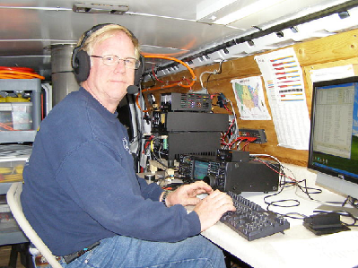
N9FN/p
Notes:
But his antennas are no better than dipoles strung high in trees between two counties, and he runs 100 watts.
So …. N9FN CAN be beaten!

Slide 32
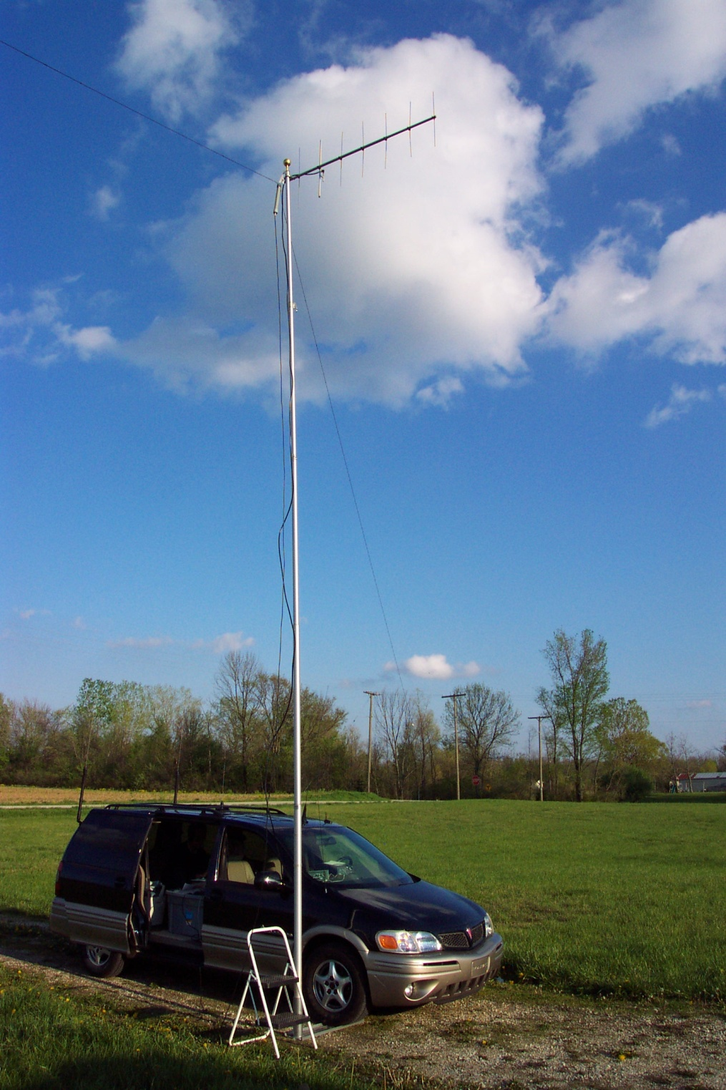
WN9O
(rover)
Notes:
But his antennas are no better than dipoles strung high in trees between two counties, and he runs 100 watts.
So …. N9FN CAN be beaten!

Slide 33
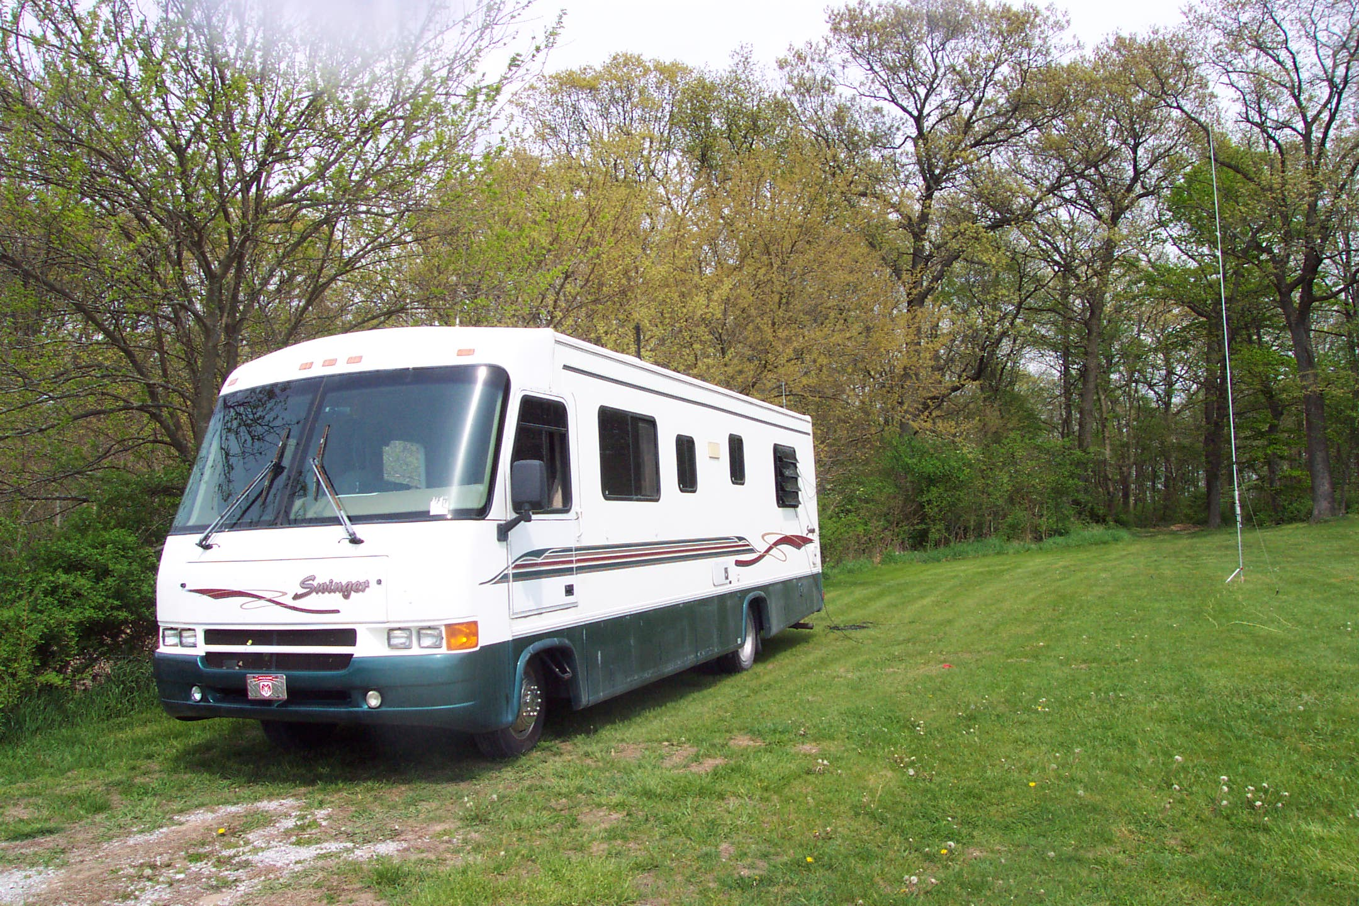
WN9O/portable
Notes:
But his antennas are no better than dipoles strung high in trees between two counties, and he runs 100 watts.
So …. N9FN CAN be beaten!

Slide 34
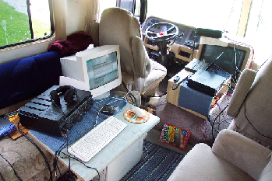
WN9O (Station A&B)
Notes:
But his antennas are no better than dipoles strung high in trees between two counties, and he runs 100 watts.
So …. N9FN CAN be beaten!

Slide 35
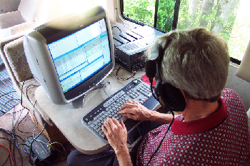
WN9O (Station C)
Notes:
But his antennas are no better than dipoles strung high in trees between two counties, and he runs 100 watts.
So …. N9FN CAN be beaten!

Slide 36
What can I do now?
Visit the INQP website
  http://www.hdxcc.org/inqp
Subscribe to the Groups.io INQP reflector
  Option - Hourly or daily digests
Look at the Operating Tips in the INQP Publicity Package on the INQP website
Stir up activity in your club
Notes:
As mentioned earlier there’s LOT of useful info as well as the rules and county abbreviations. There is also the planned activity map.
Look at the SOAPBOX to hear what 2009 operators had to say.
If you don’t want to see a bunch of INQP messages in your mailbox, opt for the daily digest (all correspondence for the day in ONE e-mail)

Slide 37
May 4, 2024
1500-0300 UTC (12 hours)
11-11 EDT
Make plans to be on from home
  (invite guest ops, be a M/S or M/M- party?)
Spot the mobiles and rovers!!!
  Rules now permit you to spot yourself.
Take it on the road yourself:
  Mobile – in 3-20 counties. Sit on a line for double QSO points (and be a double multiplier).
  As a portable (or Rover) (get landowner’s OK) .. PARKS?
  Find a county where you can set a new record (INQP records are on the website)
  Operate from a rare county as a portable... plaques!
  Prepare for the pileups
  TAKE PICTURES FOR THE ARCHIVES !!!
Notes:
You generals and extras--- or club stations ---- let the Tech class folks operate. (You must be control operator)
You canspot your self, and you can use the spotting network to find stations . But you can post spots for mobiles and rovers when they change counties... The mobiles appreciate it since they won’t be in a new county for long.
County line operation (in a SAFE location) counts as two QSOs per contact. You don’t need to straddle the line if it’s not safe, but be as close as you safely can be.
PLEASE ask for permission to operate from private property! We don’t need to overwork our law enforcement folks any more…. (We have had a few incidents in the past with “suspicious” radio antennas)

Slide 38
The top 10 “rare ones”
Adams
Boone
Carroll
Cass
Greene
Martin
Morgan
Sullivan
Switzerland
Vermillion.
Plaque for most QSOs from a rare county

Slide 39
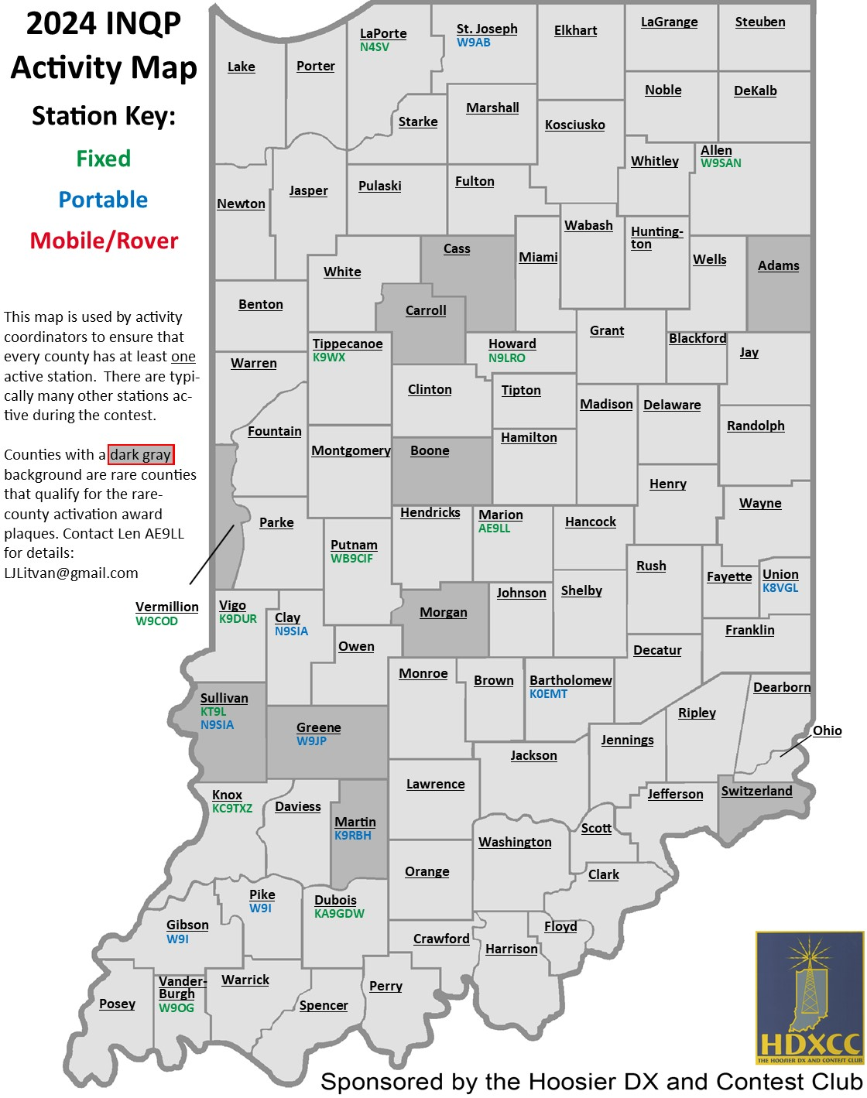
As of 3/3/224

Slide 40
Global competition that is raising QP activity
46 QSO parties in 2023
(Enter as many QSO parties as you can)
•Recognize radio amateur participation in US State and Canadian Province QSO Parties.
•Scoring: – Total number of contacts X Number of QSO Parties entered.
•”Entered” means at least 2 QSOs submitted
•Claimed Scores must be submitted to 3830Scores.com (but please also send in your log to the state party ..even if only a “check,log”)
Info at http://stateqsoparty.com/

Slide 41
QUESTIONS ???
Len Litvan AE9LL ljlitvan@gmail.com
Mark WB9CIF markmusick@sbcglobal.net
Plaque sponsors - kj9c@arrl.net

